Slide 1
Happily together: F# and T-SQL
Dmitry Morozov, DMITRY SEVASTIANOV
AUGUST 26, 2014

Slide 2
Interesting facts from JULY 2014 TIOBE Index
T-SQL – "Programming Language of the Year“ in 2013
The award is given to the programming language that has the highest rise in ratings in a year.
F# - as of today moved up 37 places since July 2013
Both are doing remarkably well

Slide 3
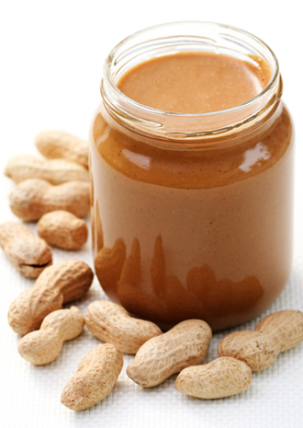
If both are so good LET’S JUST ADD them UP WHAT POSSIBLY CAN GO WRONG ?

